Slide 1
Unix System Administration
Unit 7:
  system logs
  benchmarks

Slide 2
Log files
/var/log
  boot.log
  cron
  dmesg
  maillog
  messages
  rpmpkgs
  secure
  spooler
  up2date
  Xorg.0.log
  yum.log
subdirectories:
  cups
  gdm
  httpd
    access_log
    error_log
  mail
  ppp
  samba
  squid
  vbox
also: lastlog, wtmp

Slide 3
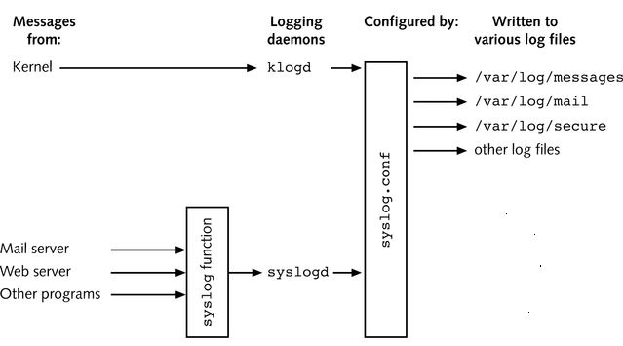
syslogd and klogd
syslog.conf syntax:
facility.priority action

Slide 4
syslog facilities
 | Meaning
kern | Linux kernel
user | user process
mail | mail system
lpr | printer system
auth | system that checks security
deamon | any other service process
local0 ... local7 | site specific
... news, uucp, mark | many more

Slide 5
syslog priorities
 | Meaning
emerg | imminent system crash
alert | condition that must be corrected immediately
crit | hardware problem
err | ordinary error
warning | warning of potential problem
notice | alert of condition that is not error
info | informational message
debug | debugging message
none | don’t report anything

Slide 6
syslog priorities
priorities have ascending order
  specified as lowest level of concern
  ex: kernel.info
  all kernel messages of priority info and higher
  ex: kernel.=info
  only “info” messages

Slide 7
syslog actions
destination for log message
  file or device
    ex: /var/log/message
    ex: - /var/log/mail (no sync after write to file)
  user that are logged in
    ex: root
    ex: * (i.e. all users logged in)
  program via pipe
    ex: | mail -s “please check” helper@other.com
  syslog process running on remote host(s)
    ex: @loghost

Slide 8
Configuration File examples
*.err;kern.debug;auth.notice /dev/console
daemon,auth.notice /var/adm/messages
lpr.* /var/adm/lpd-errs
auth.* root,nosmis
auth.* @prep.ai.mit.edu
*.emerg *
*.alert |dectalker
mark.* /dev/console

Slide 9
Managing Log Files
logrotate utility
  maintains set of log files
    rotate, compress, remove, mail
    daily, weekly, monthly
  run via cron
configuration
  /etc/logrotate.conf
  /etc/logrotate.d
    for specific installed packages

Slide 10
Benchmarks
assess system performance
Linux Benchmark Suite
  lbs.sourceforge.net
example:
  Dhrystone
  measures integer calculation performance
weekly task:
  run benchmark on your machine that is invoked via your website

Slide 11
Dhrystone
written as C program
  dhry_global.h
  dhry_pack_1.c
  dhry_pack_2.c
compile with gcc to produce dhry
  gcc dhry_pack_?.c -o dhry
place into directory:
/var/www/cgi-bin

Slide 12
Running programs via website
web server standard:
CGI: Common Gateway Interface
Perl scripting language
  especially suited to process text strings
  tool for managing html forms
  may run regular Linux programs

Slide 13
/var/www/cgi-bin/dhry.cgi
#! /usr/bin/perl
use CGI qw/:standard/;
$times = param('times');
print header, start_html("Result");
print(h1("Result"));
die("could not execute benchmark")
unless (open(LS, "./dhry $times | tail -3 |"));
@lsout = <LS>;
print "<PRE>\n";
foreach $name (@lsout) {
chomp($name);
print $name, "<br>\n";
}
print "</PRE>\n";
print end_html;

Slide 14
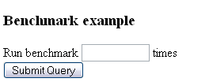
html form to invoke cgi script
<h3>Benchmark example</h3>
<FORM action=/cgi-bin/dhry.cgi method=get>
Run benchmark
<input type=text name=times size=10> times
<br>
<input type=submit>
</form>

Slide 15
enable cgi scripting
web server configuration
  /etc/httpd/conf/httpd.conf
AddHandler cgi-script .cgi
place dhry and dhry.cgi into /var/www/cgi-bin directory

